Slide 1
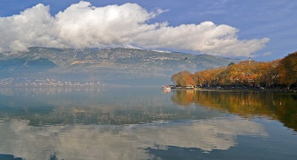
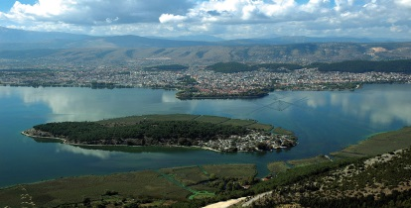
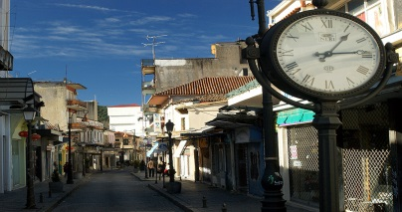
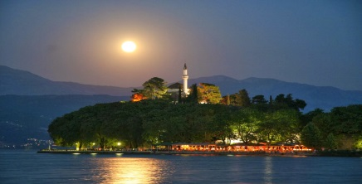
7TH European Course
On Pediatric Neuroradiology
Ioannina (Greece) , January 22-27, 2015
The Course allows ESNR Full Members, certified as Fellow in Neuroradiology, to undergo the examination for ESNR Certification of Higher Qualification in Pediatric Neuroradiology
DEADLINE FOR REDUCED FEE: NOVEMBER 28, 2014
REGISTER ONLINE AND BOOK THE BEAUTIFUL HOTEL DU LAC IN IOANNINA AT
www.ecpnr.org
of the

